Slide 1
Marketing analysis

Slide 2
Objective
Create a presentation centered around the dynamic weekday duration
Data about customer activity on an e-commerce website
Timeframe: 3 months
„You have a follow up task from your marketing manager to identify overall trends of all marketing campaigns on your ecommerce site. She is particularly interested in finding out if users tend to spend more time on your website on certain weekdays and how that behavior differs across campaigns.”
New session after 30 mins of inactivity.

Slide 3
Questions
Main KPIs
How does session time change over time / weekdays? What is the difference between campaings?
How do campaigns relate to different marketing metrics?
Are campaigns efficient?
When are users more likely to purchase?
Slicer options: country, device, customer type

Slide 4
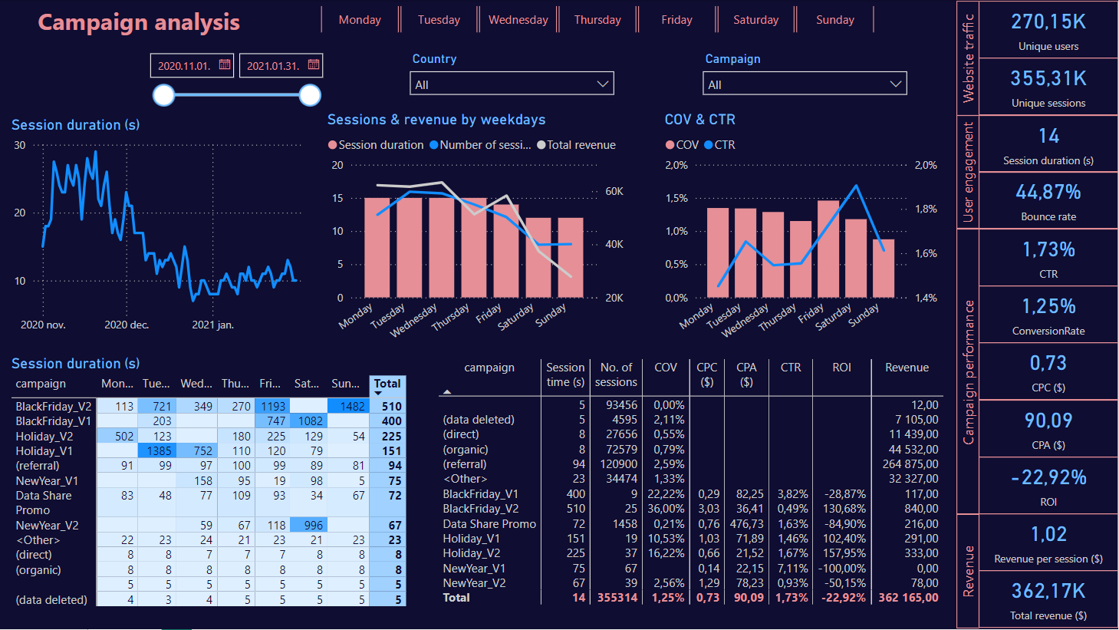

Slide 5
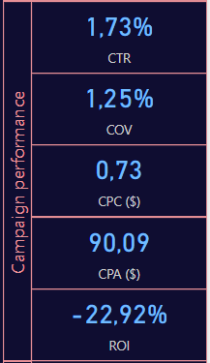
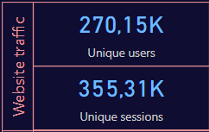
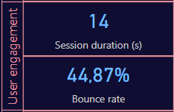
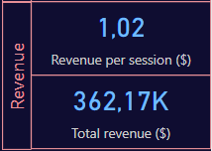
Main KPIs
High number of users and sessions
Short sessions on average
High bounce rate
Lots of users leave the session very quickly (< 10s)
Very low COV
Negative ROI on campaigns
High revenue

Slide 6
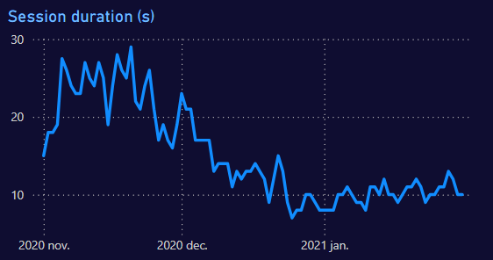
Session duration
The longest sessions (20-30s) are in November (campaign, gifts)
Slowly going down, another peak before Christmas
After the holidays it stays around 10s

Slide 7
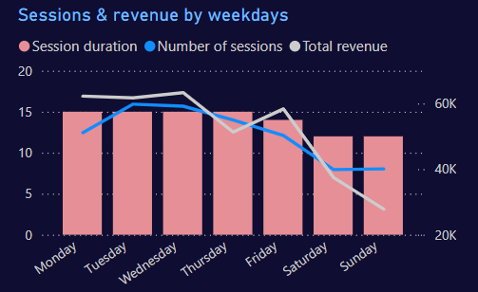
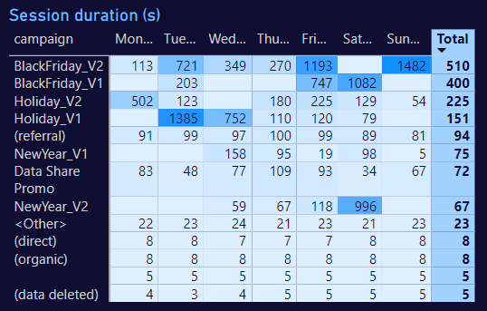
Session duration
Lower session times, number of session and total revenue on the weekends
At the beginning of the week and on Friday users tend to spend more (this time is the best for targeting)
Different holiday related campaigns have very high session times

Slide 8
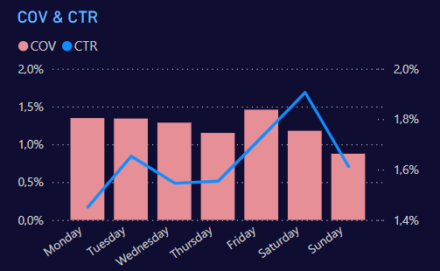
Conversion rate, Click-through rate
At the beginning of the week and on Friday more users make a purchase
CTR is the highest on Saturdays, although COV is not the highest
The weekend has lower conversion
Friday is the best for campaign advertisement

Slide 9
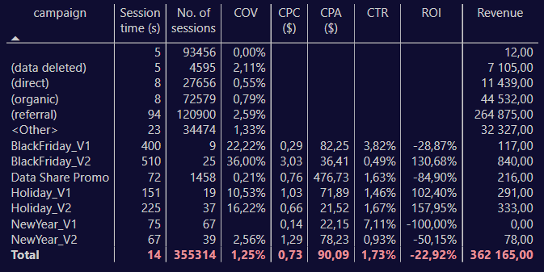
Campaign performance
In general campaigns have higher conversion rate
The total ROI for all campaigns is negative

Slide 10
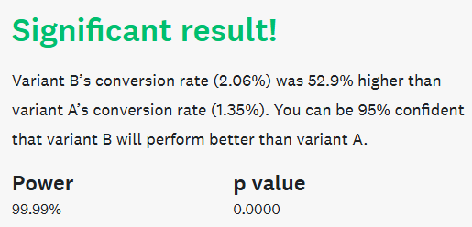
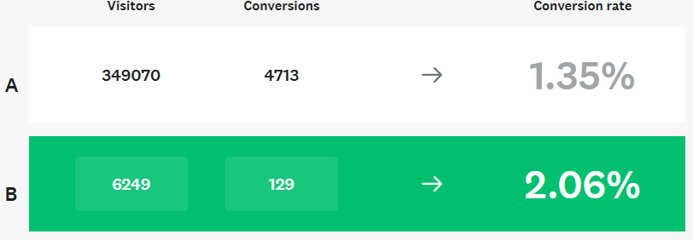





Campaign performance
With (data deleted)
Increase in COV
Session duration?
42% growth in revenue
Without (data deleted)

Slide 11
Conclusion & insights
Very high bounce rate makes the median session duration also low. Probably the website should be more engaging
Conversion rate is very low (most likely due to the high bounce rate), but it can be increased with the campaigns and targeted advertisements
Revenue per session can also be increased with the campaigns
ROI of campaigns are negative, cost should be increased, it shows other improvements

